Slide 1
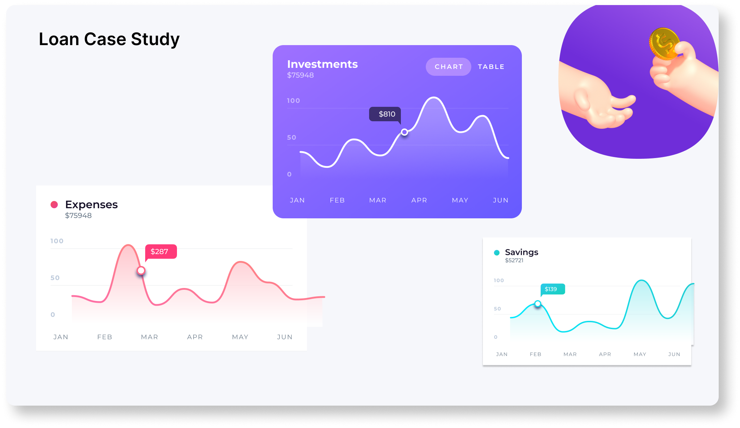
Bank Loan Case Study
Final Project-2
By - Anindya Das

Slide 2
PROJECT DESCRIPTION
This project aims at analyzing the risk appetite of banks. When the company receives a loan application, the company must decide for loan approval based on the applicant’s profile. Two types of risks are associated with the bank’s decision:
If the applicant can repay the loan but is not approved, the company loses business.
If the applicant cannot repay the loan and is approved, the company faces a financial loss.
The data given contains the information about the loan application at the time of applying for the loan. It contains two types of scenarios:
The client with payment difficulties: he/she had late payment more than X days on at least one of the first Y instalments of the loan in our sample.
• All other cases: All other cases when the payment is paid on time.
Based on the scenarios a detailed analysis must be conducted and insights needs to be drawn to help bank identify the pattern which may be used for taking actions such as denying the loan, reducing the amount of loan, lending (too risky applicants) at a higher interest rate, etc. This will ensure that the consumers capable of repaying the loan are not rejected.

Slide 3
APPROACH
I have used COUNTA function to count the total rows in each column. After that I have found the percentage of null values in each column using the formula 1- (Total Row Counts for each columns / Total Row Counts). After that I have removed all the columns having null value percentages more than 30%. For column having less than 30% null value percentages I have done mean, median and mode imputations for the missing values for columns having null value percentages less than 30%. I have also found the outliers using interquartile range method considering relevant columns. After going through each column description, I have kept only relevant columns to bring out the insights. The columns having days are converted in to years by simply dividing the days by 365.Click on the below link to open the excel file. The excel file contain all the analysis.

Slide 4

TECH STACK USED
Purpose – All the analysis has been performed in excel. This tool is also used to create graphical representation of the results and to understand the result set better.
Microsoft Excel

Slide 5
Data Analytics Tasks:
Identify Missing Data and Deal with it Appropriately: As a data analyst, you come across missing data in the loan application dataset. It is essential to handle missing data effectively to ensure the accuracy of the analysis.
Task: Identify the missing data in the dataset and decide on an appropriate method to deal with it using Excel built-in functions and features.

Slide 6
I have used COUNTA function to count the total rows in each column. After that I have found the percentage of null values in each column using the formula 1- (Total Row Counts for each columns / Total Row Counts). After that I have removed all the columns having null value percentages more than 30%. For column having less than 30% null value percentages I have done mean, median and mode imputations for the missing values for columns having null value percentages less than 30%. I have also found the outliers using interquartile range method considering relevant columns. After going through each column description, I have kept only relevant columns to bring out the insights. The columns having days are converted in to years by simply dividing the days by 365.Click on the below link to open the excel file. The excel file contain all the analysis.
DATASET- https://drive.google.com/file/d/1Y4yv3pi3T293R-sB1WKlZzfUWVthGjOU/view?usp=drive_link

Slide 7
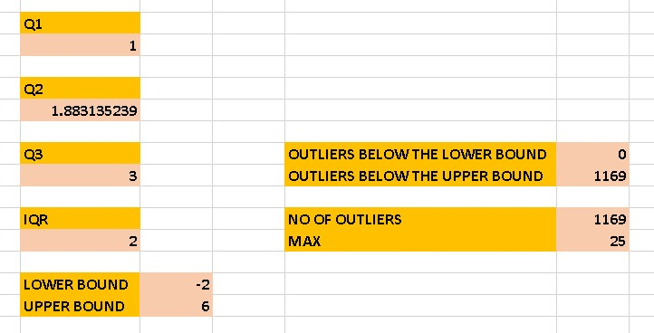
Identify Outliers in the Dataset: Outliers can significantly impact the analysis and distort the results. You need to identify outliers in the loan application dataset.
Task: Detect and identify outliers in the dataset using Excel statistical functions and features, focusing on numerical variables.

Slide 8
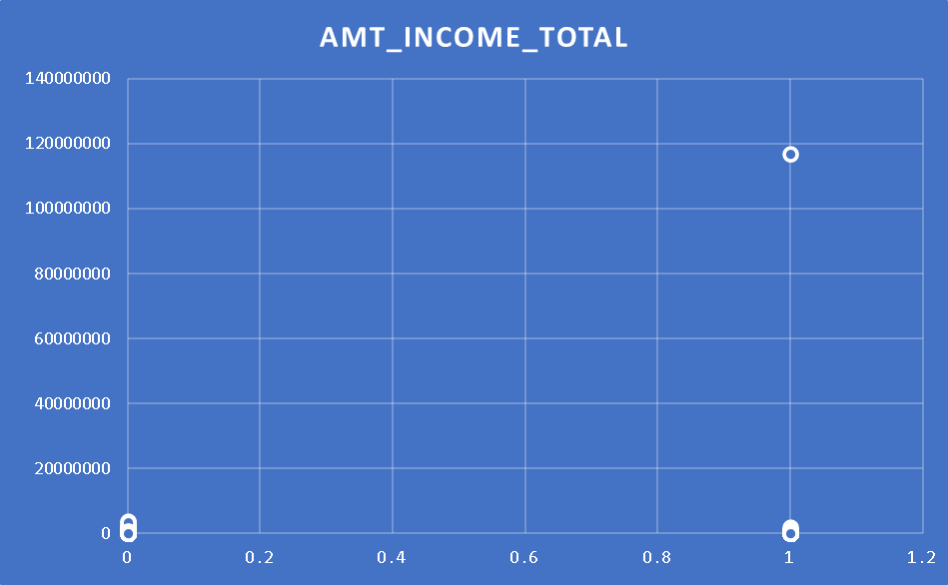
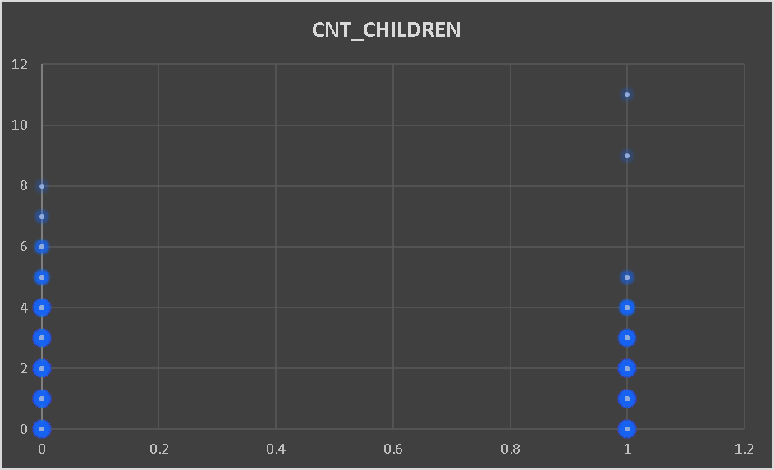
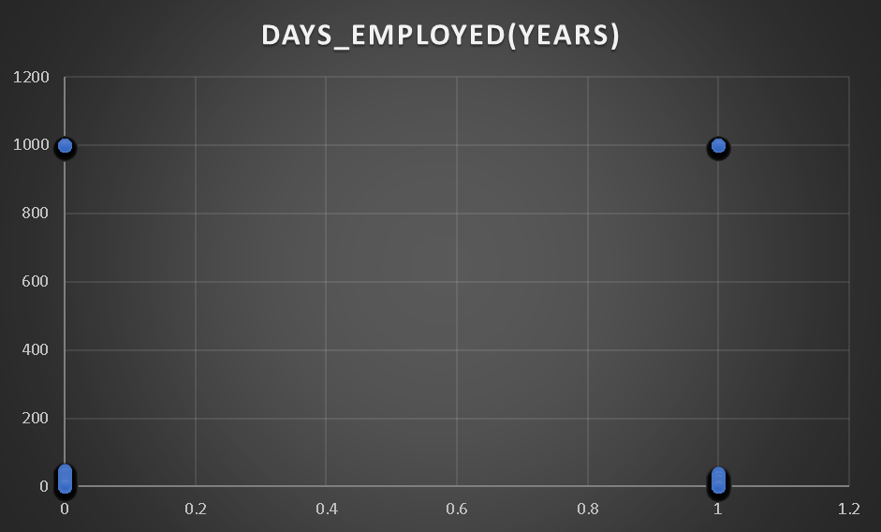

Slide 9
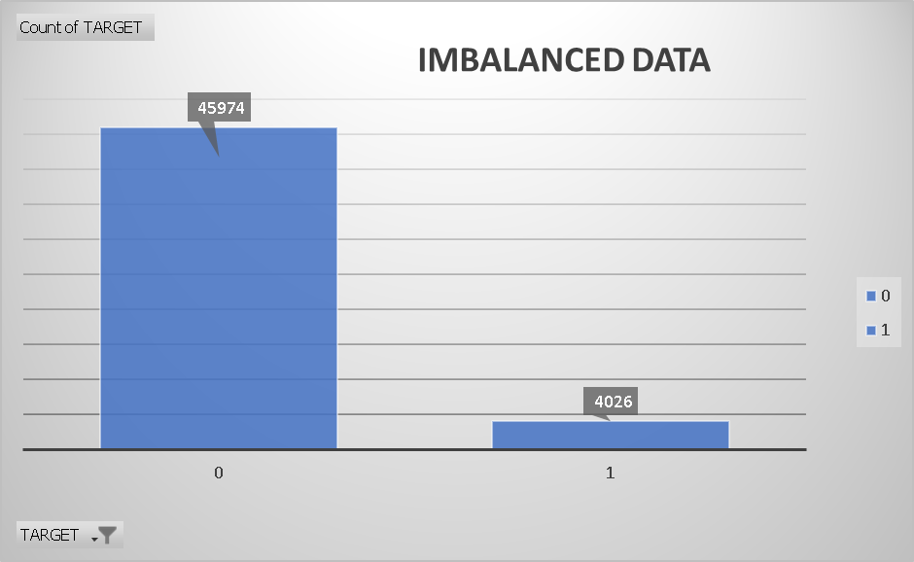
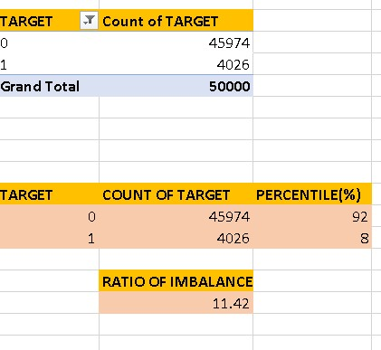
Analyze Data Imbalance: Data imbalance can affect the accuracy of the analysis, especially for binary classification problems. Understanding the data distribution is crucial for building reliable models.
Task: Determine if there is data imbalance in the loan application dataset and calculate the ratio of data imbalance using Excel functions.

Slide 10
Perform Univariate, Segmented Univariate, and Bivariate Analysis: To gain insights into the driving factors of loan default, it is important to conduct various analyses on consumer and loan attributes.
Task: Perform univariate analysis to understand the distribution of individual variables, segmented univariate analysis to compare variable distributions for different scenarios, and bivariate analysis to explore relationships between variables and the target variable using Excel functions and features.

Slide 11
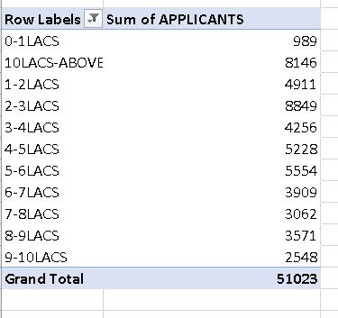
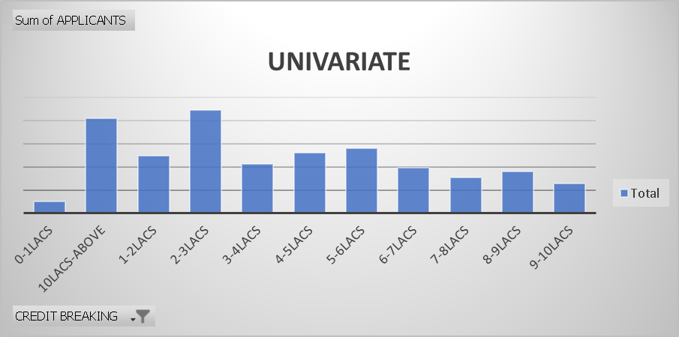

Slide 12
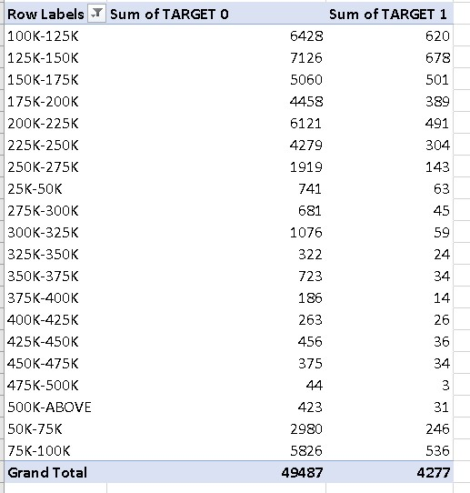
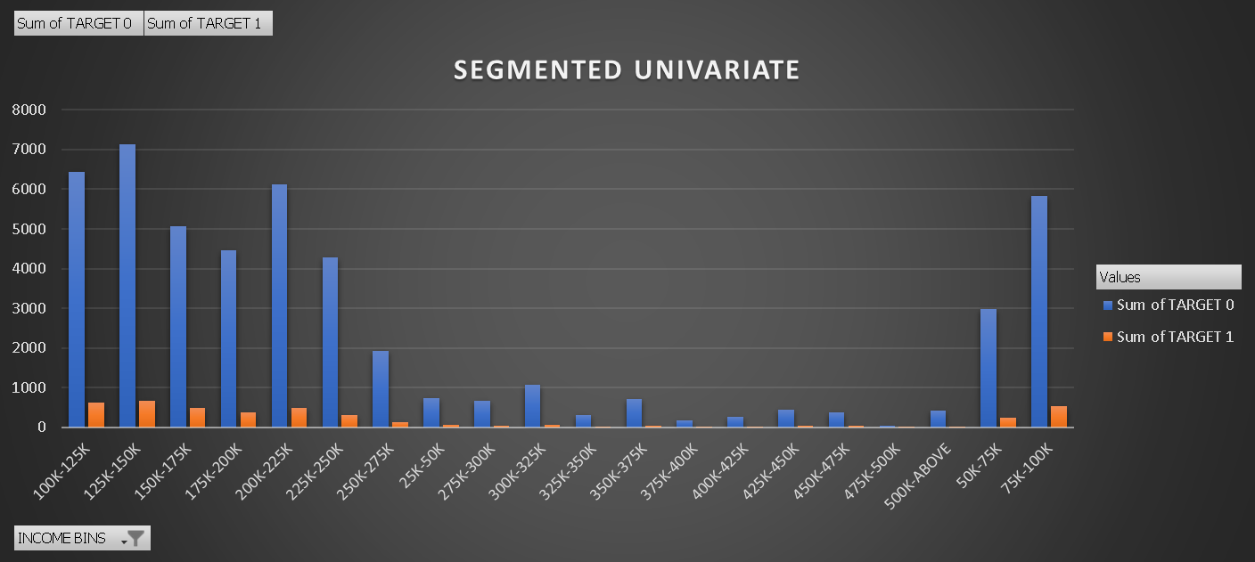

Slide 13
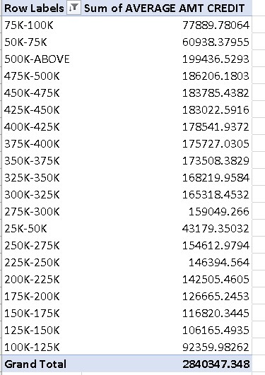
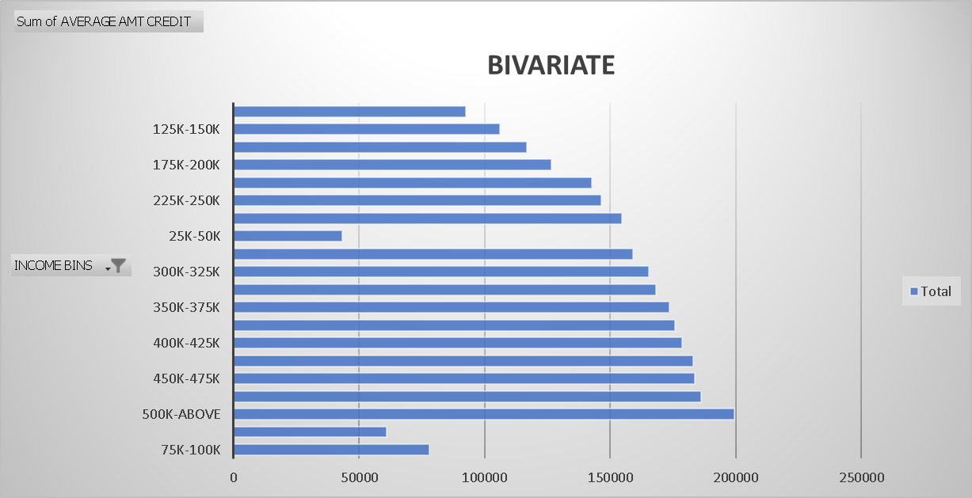

Slide 14
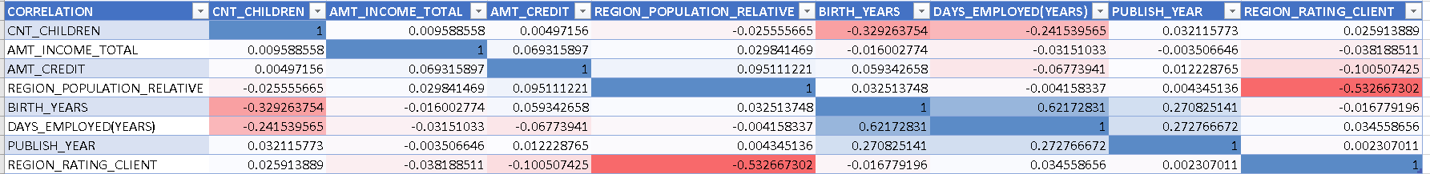
Identify Top Correlations for Different Scenarios: Understanding the correlation between variables and the target variable can provide insights into strong indicators of loan default.
Task: Segment the dataset based on different scenarios (e.g., clients with payment difficulties and all other cases) and identify the top correlations for each segmented data using Excel functions.

Slide 15
RESULT
This project helps in handling the large datasets. How exploratory data analysis can be applied to large datasets. When dealing with the large datasets it is also important to select only those columns which are extremely useful to our analysis. Finding correlations columns can become very convenient while dealing with large datasets as it saves time selecting which columns should be considered for analysis. The project also helps in understanding the various terminologies used in the banking domain. The insight drawn from the project are as follows:
Applicants drawing higher income were offered higher loan amount by the bank.
Majority of applicants drawn an income range between 1 Lacs – 1.5 Lacs, also the defaults drawn income between the same range.
Majority of applicants were offered loans in the credit range of 9 Lacs and above.

Slide 16
THANK YOU!

